Slide 1

An Efficient and Accurate Lattice for Pricing Derivatives under a Jump-Diffusion Process

Slide 2
1. Introduction
In a lattice, the prices of the derivatives converge when the number of time steps increase.
Nonlinearity error from nonlinearity option value causes the pricing results to converge slowly or oscillate significantly.

Slide 3
Underlying assets : Stock
Derivatives : Option
CRR Lattice Lognormal diffusion process
Amin’s Lattice
HS Lattice Jump diffusion process
Paper’s Lattice

Slide 4
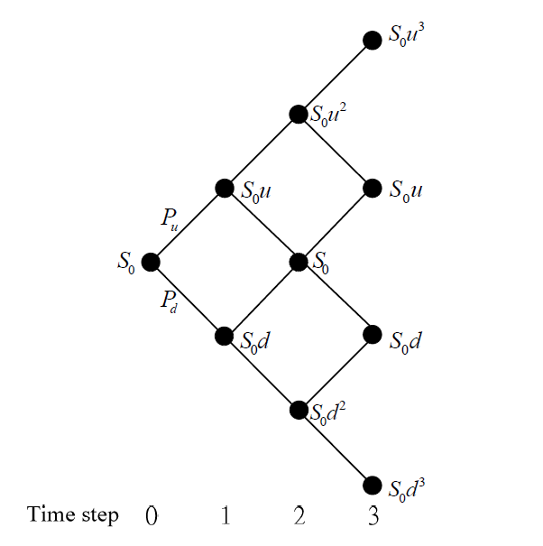
CRR Lattice
Lognormal Diffusion Process
Su with
Sd with
=1-
d < u
ud = 1

Slide 5
Problem !?
Distribution has heavier tails & higher peak ☹
----------------------------------------------------------------
Jump diffusion process ☺!!!
↙ ↘
Diffusion component Jump component
↓ ↓
lognormal diffusion process lognormal jump (Poisson)

Slide 6
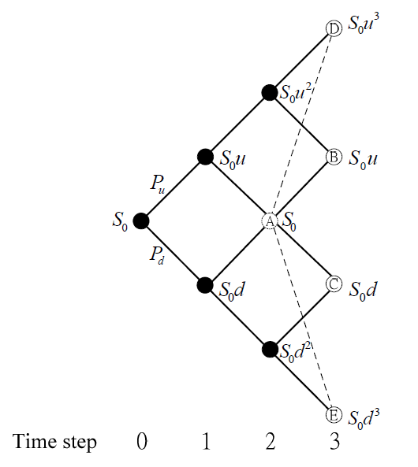
Amin’s Lattice
less accurate !?
Volatility
(lognormal jump
> diffusion component)

Slide 7
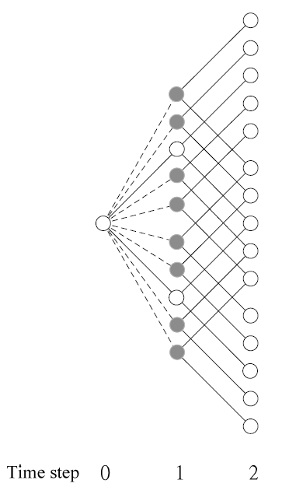
Hilliard and Schwartz’s (HS) Lattice
Diffusion nodes
Jump nodes
Rate of

Slide 8
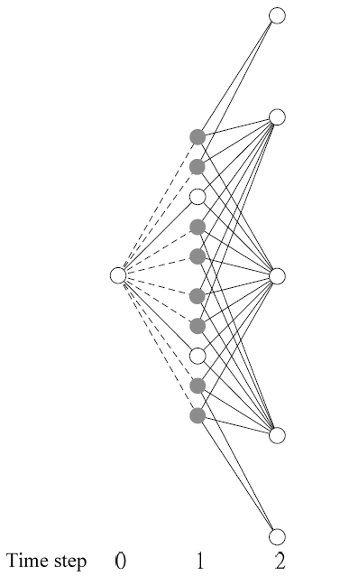
Paper’s Lattice
Trinomial structure
lower the node
Rate of

Slide 9
2. Modeling and Definitions
The risk-neutralized version of the underlying asset’s jump diffusion process

Slide 11
Financial knowledge (Pricing options)
{
{

Slide 12
3. Preliminaries
(a) CRR Lattice
jump diffusion process (λ=0)

Slide 14
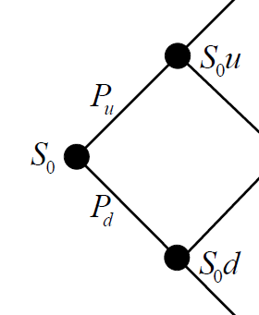
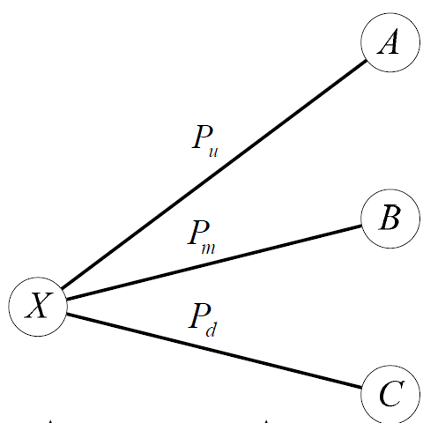

Slide 15
(b) HS Lattice

Slide 16
Continuous-time distribution of the jump component
→ obtain 2m+1 probabilities from solving 2m+1 equations

Slide 17
Pricing option

Slide 18
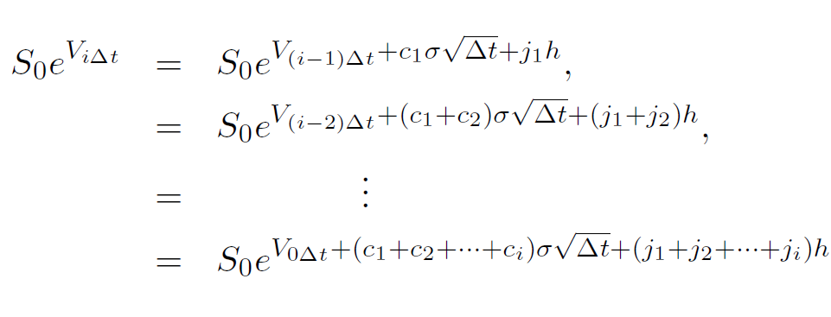
Complexity Analysis

Slide 19
Problem !? 1. time complexity 2. oscillation

Slide 20
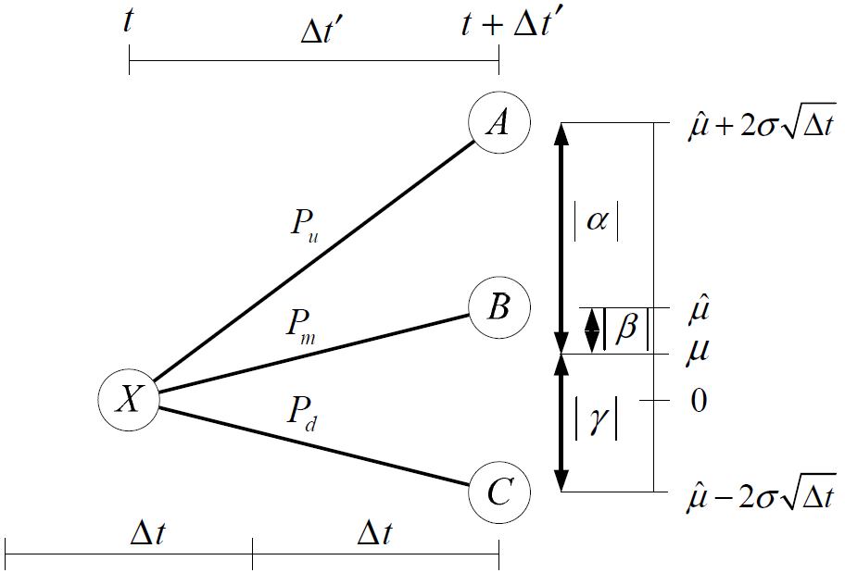


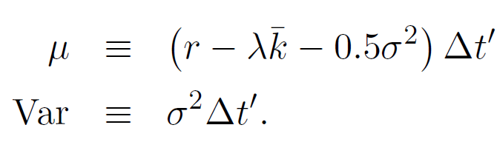

4. Lattice Construction
Trinomial Structure

Slide 21
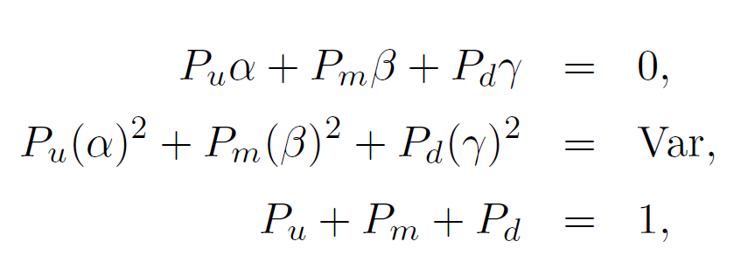
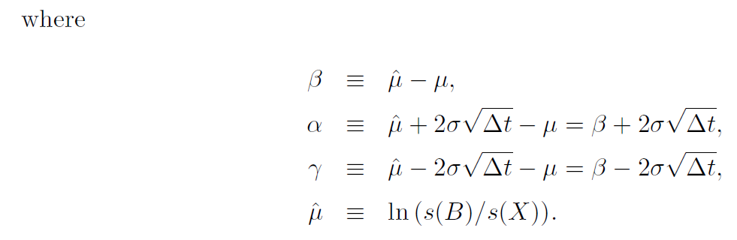

Slide 22
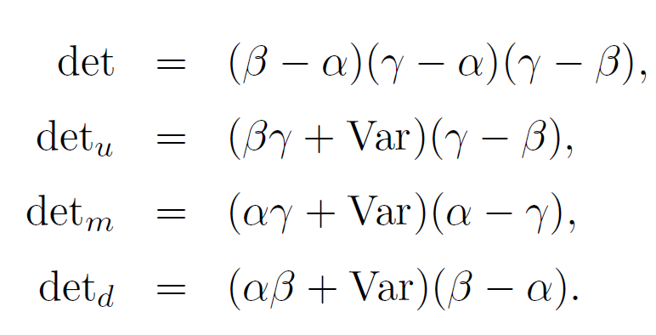



→ Cramer’s rule

Slide 23

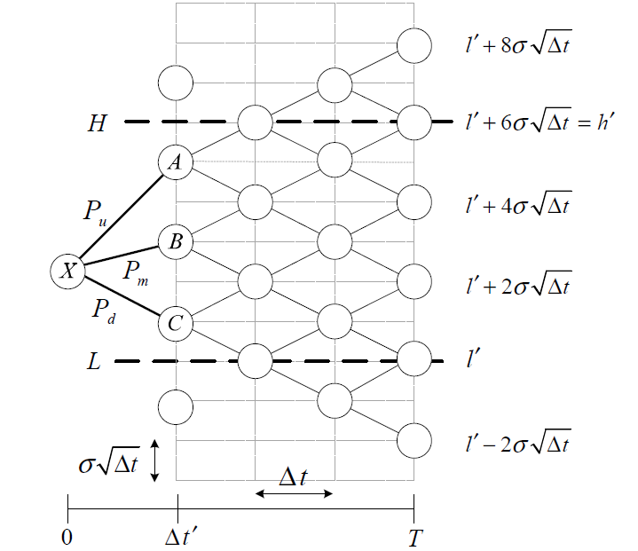

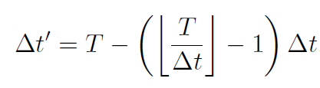

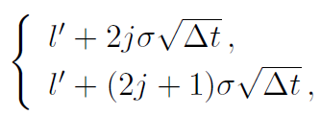

fitting the derivatives specification

Slide 24
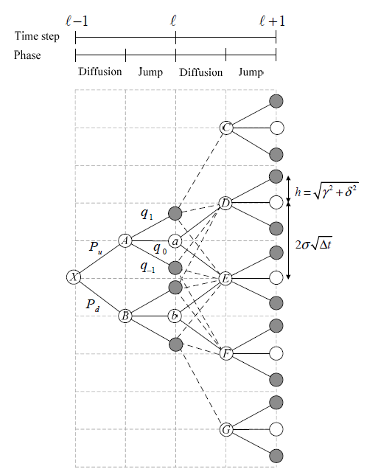




Jump nodes

Slide 25
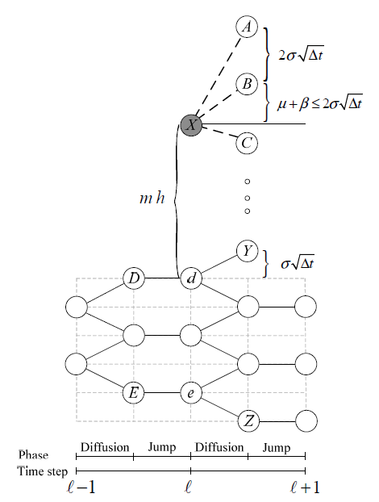
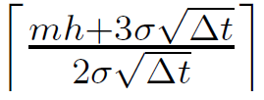
Complexity analysis

Slide 26
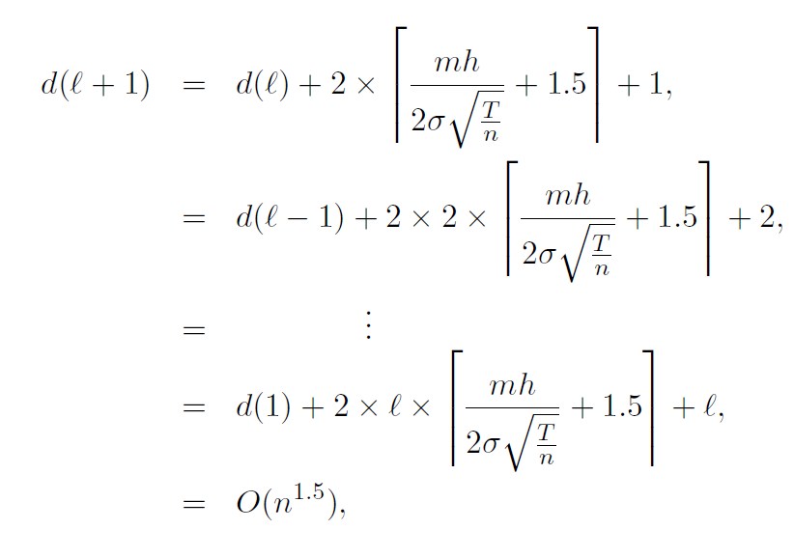



Slide 27
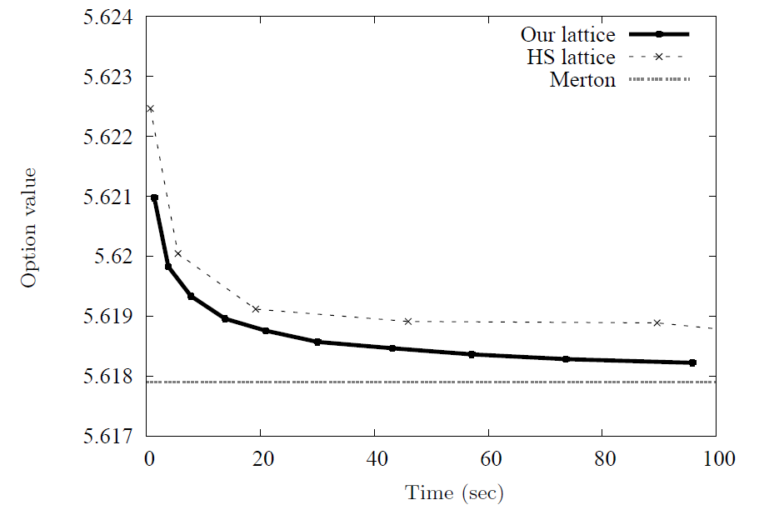
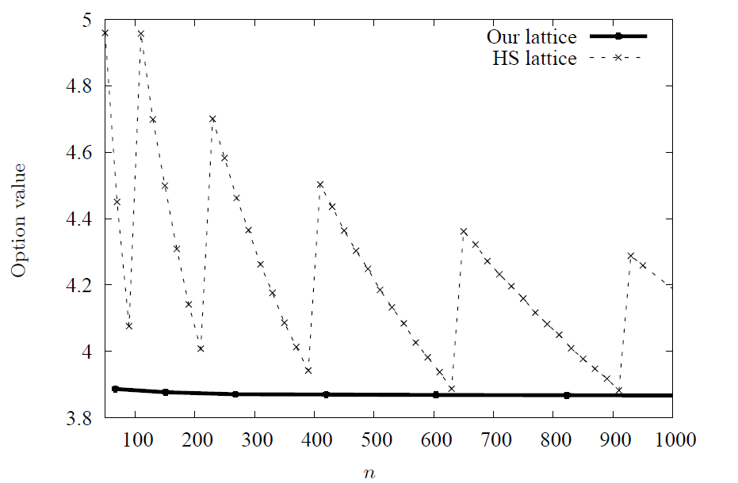
5. Numerical Results

